Slide 1
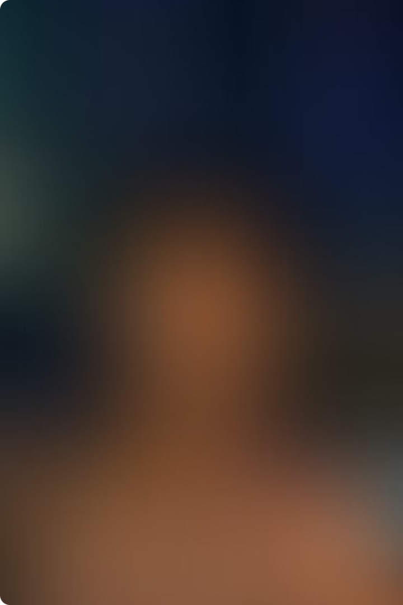
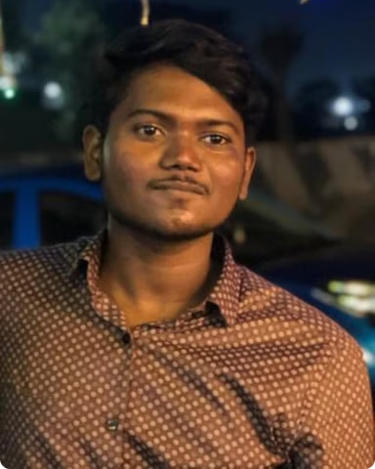
Student Details:
Name: Gokul M
Skill Build E-mail ID: gokulmanickam57@gmail.com
College Name: B.S. Abdur Rahman Crescent Institute of Science and Technology
College State: Tamil Nadu
Internship Domain: Front End Developer
Start and End Date: June 24 to July 31
As part of my front-end development internship, I had the opportunity to clone an existing website, leveraging my skills in HTML, CSS, and JavaScript to create a visually appealing and user-friendly interface.

Slide 2

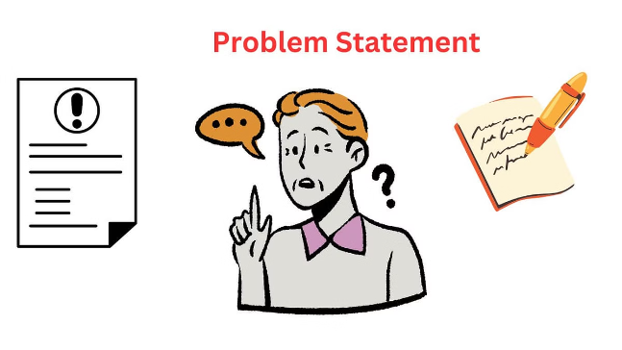
Project Problem and Statement
1
Identifying the Problem
2
Defining the Solution
My task was to clone the existing website, maintaining its core functionality while enhancing the overall user experience and visual design.
The client wanted a modern and responsive website that could effectively showcase their products and services to potential customers.
3
Addressing Challenges
I needed to analyze the current website, understand its strengths and weaknesses, and develop a plan to address any issues or limitations.

Slide 3
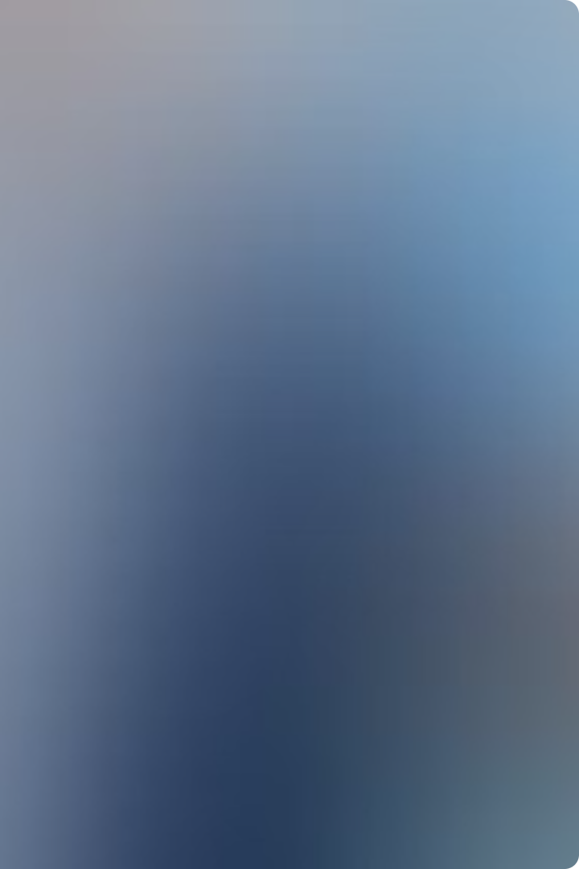

Project Agenda
1
Analysis
Thoroughly examine the existing website, its structure, and user experience.
2
Design
Develop a new design concept that aligns with the client's brand and enhances the website's overall appeal.
3
Development
Implement the new design using HTML, CSS, and JavaScript, ensuring a seamless user experience.

Slide 4

Project Overview
Objectives
Scope
Deliverables
To create a visually appealing and user-friendly website that effectively showcases the client's products and services.
The project involved cloning the existing website, improving its design, and enhancing its functionality.
A responsive and mobile-friendly website that meets the client's requirements and provides a seamless user experience.

Slide 5


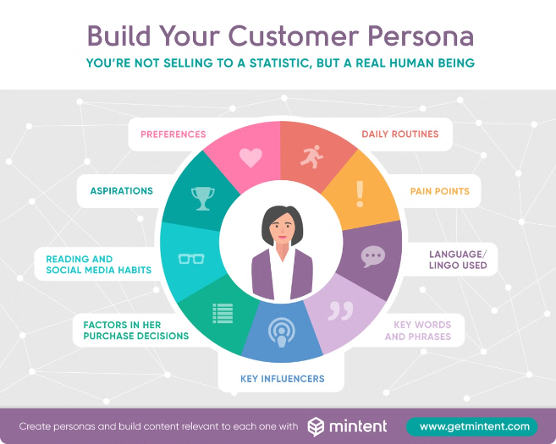


End Users
Customers
The primary end users are the client's customers who will interact with the website to learn about the products and services.
Clients
The client, who commissioned the website, will use it to effectively showcase their offerings and attract new business.
Stakeholders
The website's performance and analytics will be monitored by the stakeholders to assess its success.

Slide 6

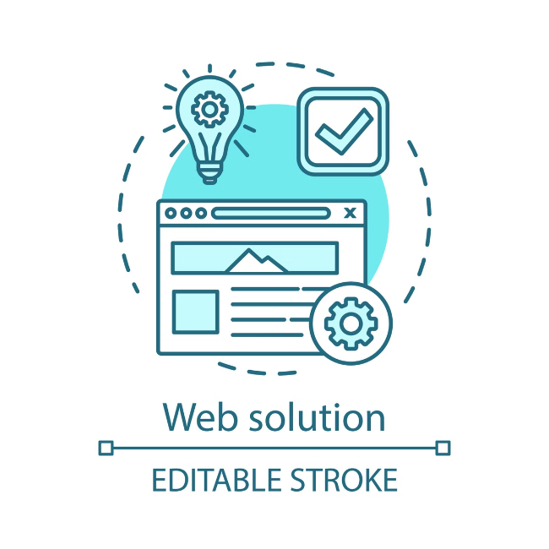
My Solution and its Value Proposition
Responsive Design
Improved Usability
The cloned website is fully responsive, ensuring a seamless user experience across all devices.
Enhanced navigation, clear product information, and a user-friendly interface make it easy for customers to find what they need.
Increased Engagement
Streamlined Operations
Visually appealing design, engaging content, and interactive elements encourage users to explore the website further.
The website's efficient structure and functionality help the client manage their online presence more effectively.

Slide 7
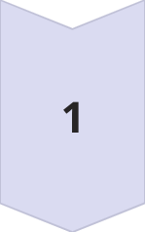
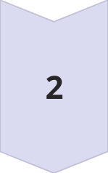
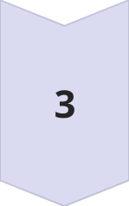
Customizing the Project
Branding
I incorporated the client's brand guidelines, including their logo, color scheme, and typography, to ensure a consistent and cohesive visual identity.
User Experience
Based on user research and feedback, I optimized the website's navigation, content structure, and interactive elements to enhance the overall user experience.
Functionality
I added custom features and integrations, such as a product configurator and a customer support chat, to meet the client's specific requirements.

Slide 8


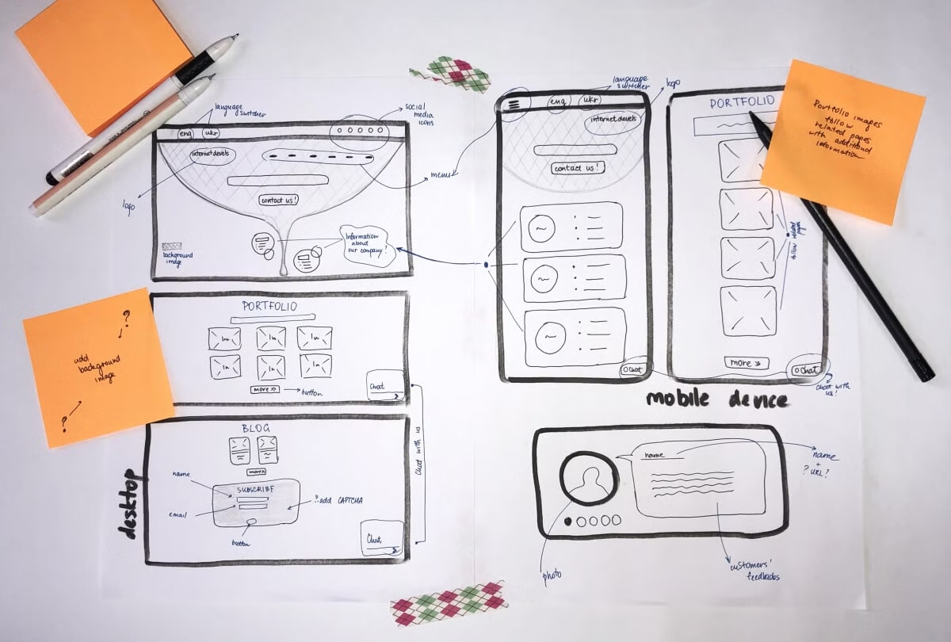
Modelling
1
Wireframing
I created detailed wireframes to plan the website's layout, information architecture, and user interactions.
2
Prototyping
I developed interactive prototypes to validate the design concepts and gather feedback from the client and end-users.
3
Optimization
Based on the feedback, I refined the design and made iterative improvements to ensure the website meets the desired objectives.

Slide 9
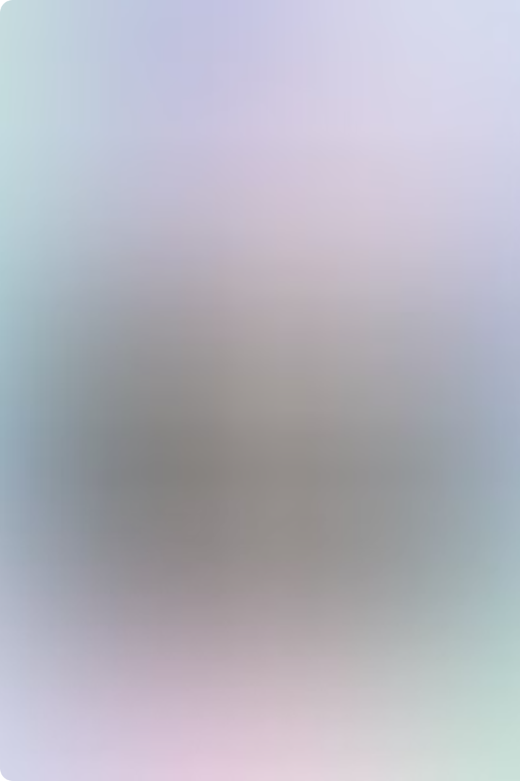

Results
1
Increased Engagement
2
Improved Conversions
The cloned website saw a significant increase in user engagement, with higher page views, longer session durations, and lower bounce rates.
The website's streamlined user experience and enhanced functionality led to a noticeable increase in customer inquiries and sales conversions.
3
Positive Feedback
The client and end-users provided overwhelmingly positive feedback on the website's design, usability, and overall user experience.

Slide 10

Project Link
You can view the cloned website at ​https://github.com/Gokul-MK/Netflix-Clone​. Feel free to explore the website and provide any feedback or suggestions.

Slide 11

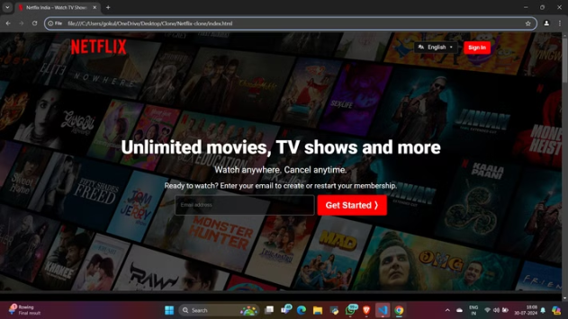
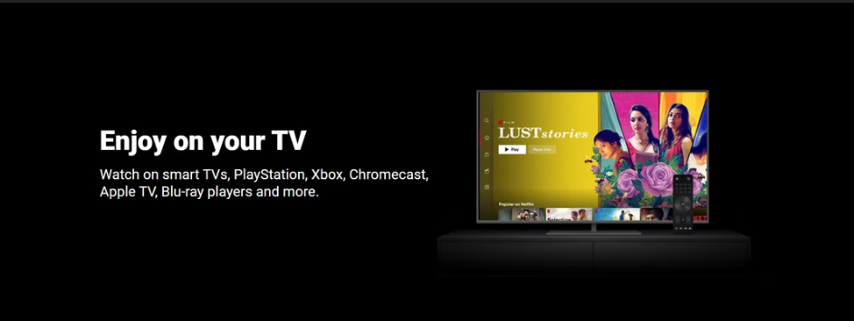
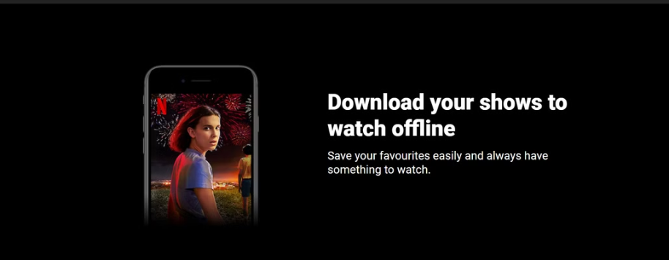
Sample Pages:

